Slide 1
Basics

Slide 2
Input statement
Definition and Usage
The input() function allows user input.
Syntax
input(prompt)
Parameter | Description
prompt | A String, representing a default message before the input.
input() Return Value
The function returns the user's input in the form of a string.

Slide 3
Example 1
Write a program that ask for the user's name and print it:
print('Enter your name:')
x = input()
print('Hello, ' + x)

Slide 4
Example 2
Example: Taking the Name and Age of the user as input and printing it
# Taking name of the user as input and storing it name variable
name = input("Please Enter Your Name: ")
# taking age of the user as input and storing in into variable age
age = input("Please Enter Your Age: ")
#display
print("Name & Age: ", name, age)

Slide 5
Multiple Input in Python
We are taking multiple input from the user in a single line, splitting the values entered by the user into separate variables for each value using the split() method.
Example
# taking two inputs at a time
x, y = input("Enter two values: ").split()
print("Number of boys: ", x)
print("Number of girls: ", y)
Output
Enter two values: 5 10
Number of boys: 5
Number of girls: 10
It prints the values with corresponding labels, either two or three, based on the number of inputs provided by the user.

Slide 6
Print Numbers in Python
Need to convert the input to an integer using typecasting
# Taking input as int
# Typecasting to int
n = int(input(“what is your age? "))
print(n)

Slide 7
Print Float/Decimal Number in Python
# Taking input as float
# Typecasting to float
price = float(input("Price of each rose?: "))
print(price)
Output
Price of each rose?: 50.3050.3
The code prompts the user to input the price of each rose as a floating-point number, converts the input to a float using typecasting and then prints the price.

Slide 8
Find DataType of Input in Python
In the given example, we are printing the type of variable x. We will determine the type of an object in Python.
a = "Hello World"
b = 10
c = 11.22
​print(type(a))
print(type(b))
print(type(c))
<class 'str’>
<class 'int’>
<class 'float’>

Slide 9
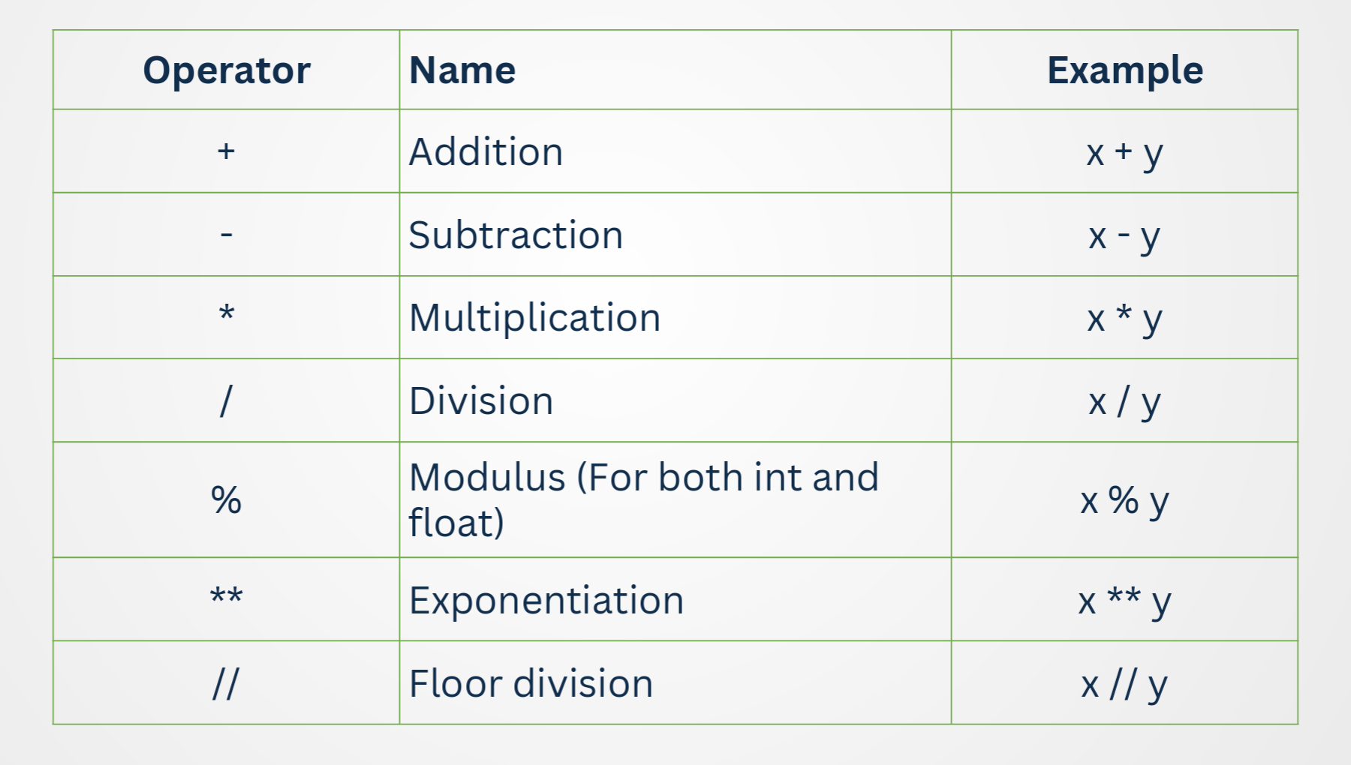
Arithmetic Operators

Slide 10
Floor division
Floor division means dividing two numbers and rounding down the result to the nearest whole number (integer).
print(10 // 3) # Output: 3 (10 ÷ 3 = 3.33 → floor = 3)

Slide 11
Programs based on arithmetic operators
Example 1. Write a program to add two numbers
# Program to add two numbers
num1 = 10
num2 = 20
sum= num1 + num2
print("The sum of", num1, "and", num2, "is:", sum)

Slide 12
Addition of 2 numbers
# Program to add two numbers
# Input two numbers
num1 = float(input("Enter first number: "))
num2 = float(input("Enter second number: "))
# Add the numbers
sum = num1 + num2
# Display the result
print("The sum of", num1, "and", num2, "is:", sum)

Slide 13
Programs based on arithmetic operators
Program 1. Write a program to add two numbers
Formula a+b
Program 2. Write a program to find area of circle.
Formula Area = π × r²
Program 3. Write a program to calculate area of rectangle
Formula. Area = length × width
Program 4. Write a program to calculate circumference of circle Formula. Circumference = 2 × π × r
Program 5. Write a program to find perimeter of rectangle.
Formula. Perimeter = 2 × (length + width)

